Slide 1
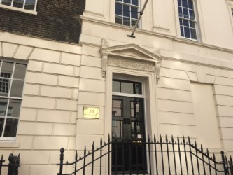
Holmes Investment Properties
Holmes Investment Properties
Property Company to
David Lloyd Adventure Parks
An Opportunity
To Invest

Slide 2
Holmes Investment Properties
A family-backed
company with
60 years of
experience and excellence in property
Since the 1950s: Surveying, estate agency, property investment and management

Slide 3
David Lloyd Adventure Parks
Ex-Professional Tennis Player
Successful Leisure Entrepreneur
David Lloyd Adventure Parks:
A new generation of David Lloyd leisure centres

Slide 4
David Lloyd – builder of the biggest leisure company in the UK
Mr. Lloyd launched David Lloyd Leisure Centres in 1982
Now 91 clubs, with turnover at £325M*
The highest turnover per club in the leisure sector
Over 400,000 members – the most in the UK
Most members per club versus compeitiors
Over 6,000 staff
*last public accounts 2013
Sold 3 times in 20 years for nearly £2 billion

Slide 5
David Lloyd Leisure Centres – most valuable clubs
Rev per club: £3.5M
Est. profit per club: £1.3M*
Value per club: £8.2M
Members per club: 4,395
UK members: 400,000
* 2012 figures
Rev per club: £2.38M
Est. profit per club: £464k
Value per club: £3.06M*
Members per club: 3,882
UK members: 392,000
* 2015 figures on sale to Brait
Rev per club: £1.4M
Est. profit per club: £121k
Value per club: £4.54M*
Members per club:2,954
UK members: 195,000
* Internal value

Slide 6
PropCo/OpCo works for competitors
even at much lower returns
Bannatyne’s Leisure Club runs a PropCo/OpCo strategy
66 clubs, 39 have been sold to M&G Investments on a 125-year lease
M&G paid an average of £2.35M per club
Bannatyne OpCo makes £121k profit per club per annum
David Lloyd’s first new club is making superior returns: £600k per annum
David Lloyd has built more value in leisure centres than anyone else in the UK

Slide 7
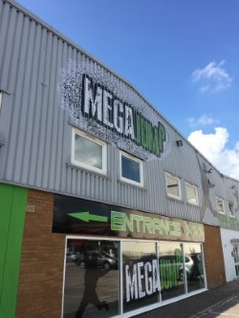
HIP to fund sites for David Lloyd Adventure Parks
First David Lloyd
Adventure Park:
MegaJump in North London
30 year minimum contract premium with 8% yield

Slide 8
Fund II
David Lloyd
David Lloyd’s MegaJump Adventure Parks
MegaJump, Borehamwood, London
Over 100 connected trampolines – fun for everyone
The ultimate family trampoline destination

Slide 9
Fund II
David Lloyd
David Lloyd’s MegaJump Adventure Parks
A highly cash generative business
A post-revenue company
With a jump start already…
The MegaJump, Borehamwood, Trampoline Park
Investment covered in year one

Slide 10
Fund II
David Lloyd
Roll out Adventure Park sites across the UK
To expand David Lloyd Adventure Parks needs fast action to ensure market leadership
Strong economic development and growing population in UK has driven up cost of securing sites
Therefore, a PropCo (HIP) is needed to support the OpCo (MegaJump Adventure Parks)
Cross shareholding between PropCo & OpCo

Slide 11
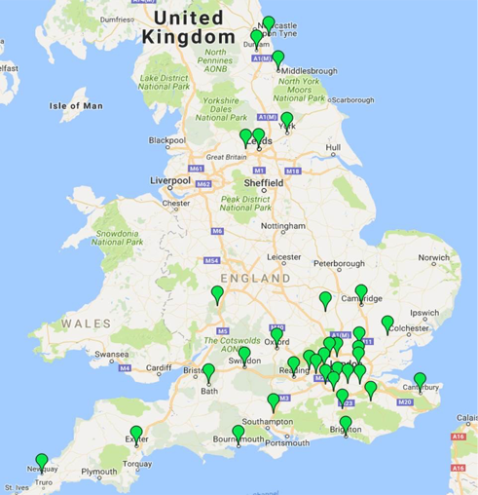
Fund II
David Lloyd
Adventure Parks targeted cities – 35 to date
Bath Leeds
Bedford Maidenhead
Borehamwood Middlesborough
Bournemouth New Malden
Bradford Newquay
Braintree Orpington
Brighton Oxford
Cambridge Reading
Canterbury Swindon
Chigwell Tonbridge
Crawley Sunderland
Croydon Uxbridge
Durham Watford
Exeter Weybridge
Harlow Winchester
Ilford Windsor
Leatherhead Worcester
York
Planned targets

Slide 12
Holmes Investment Properties – PropCo
David Lloyd
David Lloyd - non-exec Chairman of HIP
HIP PropCo to have 15% share in Adventure Park MegaJump OpCo
Contract with OpCo to fund at least 12 sites, 30-year minimum deal
Long contractual rent of 8% per annum per site with break clauses each decade with upwards only rent reviews
HIP to raise capital to fund/purchase at least 12 Adventure Parks sites
Cross shareholding between companies

Slide 13
Fund II
David Lloyd
Roll out David Lloyd Adventure Parks
Adventure Park sites will be acquired, pre-planning, for up to £1m
With planning permission, sites will be valued at £2m
Investment per site to build and fit out is expected to be £3.9m each
HIP’s experience says re-valuation would be £6 - £7m within 18 months
Leased back to OpCo at 8% yield
8% yield on all Adventure Park sites

Slide 14
Fund II
David Lloyd
Revenue drivers of MegaJump
A post-revenue company with a demonstrable proof of concept
Highly experienced management team
Significant end-user satisfaction
A market about to explode with significant growth prospects
First Adventure Park MegaJump venue profitable within month one
Balanced revenue between activities/food & beverage - 75/25
Balanced revenue between activities

Slide 15
Fund II
David Lloyd
The trampoline leisure market
The International Association of Trampoline Parks (IATP) estimates that by the end of this year there will be more than 550 indoor trampoline parks open worldwide
Compare this up to 100,000 leisure centres around the globe and the opportunity is huge and will grow fast in the western world over the next 5 years
A tipping point has been reached and the market is ripe for exploitation
A tipping point has been reached

Slide 16
Fund II
David Lloyd
The trampoline leisure market
Samantha Lyster, Journalist at Property Week says:
“Trampoline parks already seem to be catching landlords’ attention, and if more property owners become convinced of their potential, trampolining could be poised to become the country’s new fitness craze”
Trampolining – the new fitness craze

Slide 17
Fund II
David Lloyd
The trampoline leisure market
Steve Henderson, retail director at Savills, says:
“The first Gravity trampoline park at Xscape in Yorkshire, has had a very positive effect on footfall figures…the parks are an ideal way for landlords to fill space that doesn’t appeal to retailers and we are now looking for additional units between 6,000 sq ft and 16,000 sq ft in high footfall areas such as shopping centres, high streets and retail or leisure parks.”
Multiple sites in many locations available

Slide 18
Fund II
David Lloyd
Team GB’s Olympic success will drive popularity
Medals deliver Govt funding for 2020 Olympics

Slide 19
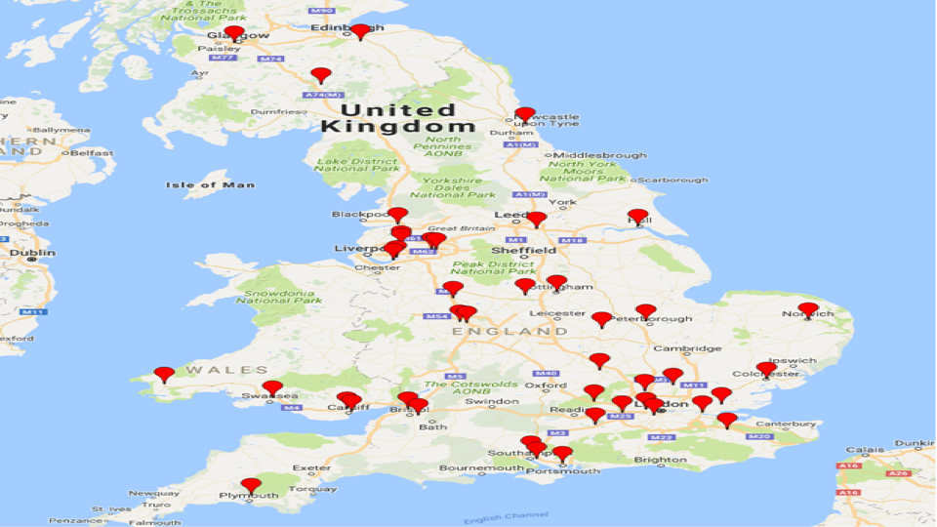
Fund II
David Lloyd
UK trampoline leisure market – current venues
43 current trampoline centres

Slide 20
Fund II
David Lloyd
The UK trampoline leisure market – the future
43 current trampoline centres: 19 competitors, none dominant
19 more centres planned by competition across Great Britain
Venues small enough for diverse range of sites
David Lloyd has targeted up to 35 prospective cities
MegaJump’s property partner, Holmes Investment Properties (PropCo) plans to fund at least 12 MegaJump centres through to to 2019
In time for 2020 Tokyo Olympics for peak popularity
Venues can be on diverse range of sites

Slide 21
Fund II
The investment opportunity
David Lloyd
A two-stage process for Holmes Investment Properties (PropCo)
Part One: Equity shareholding
Part Two: Capital loans
Imminent listing proposed

Slide 22
Fund II
David Lloyd
The PropCo investment case
£ millions
Figures rounded
2017 2018 2019 2020 2021 2022
No of Adventure Park sites 3 5 8 12 12 12
Net Income 0.0 0.5 11.9 9.4 15.0 17.1
Profit before Tax (0.05) (0.03) 10.5 7.7 12.7 14.5
Equity Raise (MJ) 6.0 6.0
Enterprise value (8x) 4.4 19.9 61.9 94.2 146.6 166.7

Slide 23
Fund II
The investment opportunity
David Lloyd
A two-stage process for Holmes Investment Properties (PropCo)
Part One: Equity shareholding
Part Two: Capital loans
Imminent listing proposed

Slide 24
Fund II
David Lloyd
The investment plan for HIP Plc
Proposal to list HIP Plc in 2016
2016 equity call - £6m to fund Adventure Park MegaJump expansion
Further equity call in 2017
Borrowing guaranteed – 60% on sites, 100% for build
5 year plan with potential exit
Listing, equity and borrowings

Slide 25
Fund II
David Lloyd
HIP and Adventure Park - Summary
Interconnected companies – HIP (PropCo) & Adventure Parks (OpCo)
Proof of concept
Cross shareholding
Separate operating company and property company
Both companies have family history, big names and sector experience
Mix of equity raise and borrowings
Consider five year exit

Slide 26
Fund II
David Lloyd
The Board of Directors
David Lloyd
Martin Helme
Nicholas Holmes
Charles Gregory
Brian Morris
Broad experience & expertise

Slide 27
Holmes Investment Properties
Contact:
Holmes Investment Properties
53 Davies Street, Mayfair, London, W1K 5KH
Martin Helme – 07779 601 541
James Holmes – 07717 411 268
David Dean – 07962 802 540

